Slide 1
Data Analysis
Data analysis is an important stage of the research process.
Data Analysis is the process of transforming data into information.
It identifies the relationship between variables.

Slide 2
Presenting data in figure/charts
BAR CHART
A diagram in which numerical values of variables are represented by the height or length of lines or rectangles of equal width.
There are various bars:

Slide 3
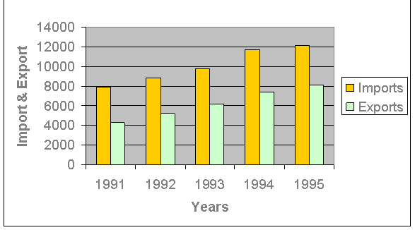
Component Bar

Slide 4
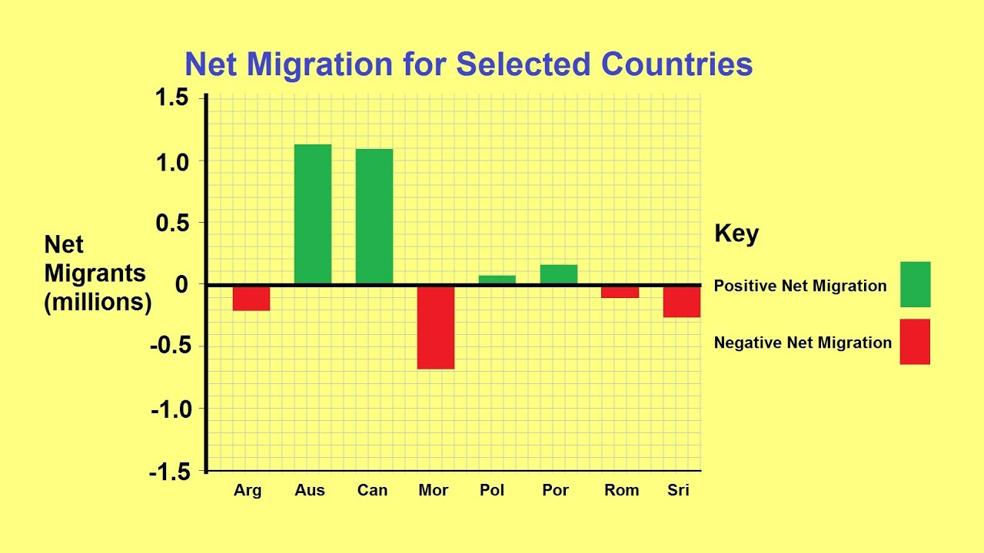
Positive Negative Bar

Slide 5
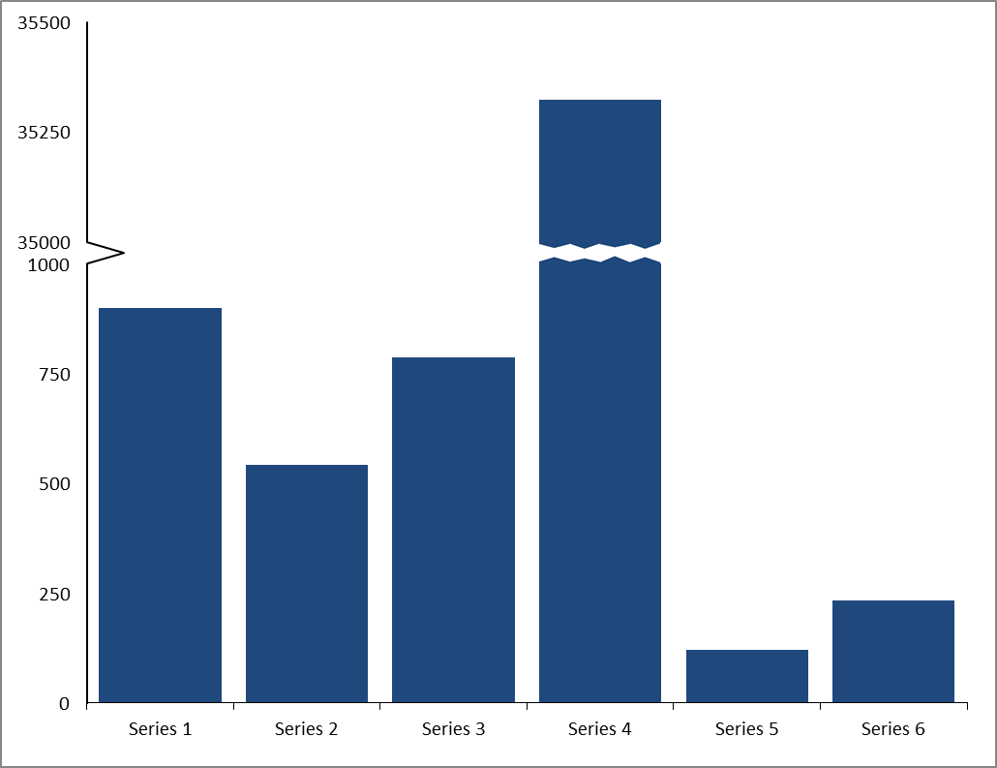
Broken Bar Chart

Slide 6
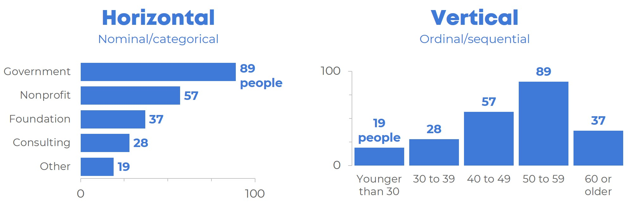
Horizontal and Vertical Bar Chart

Slide 7
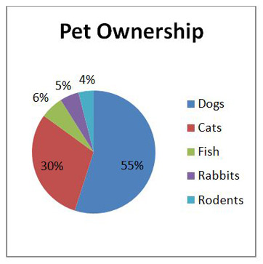
Pie Chart
A type of graph in which a circle is divided into sectors that each represent a proportion of the whole.

Slide 8
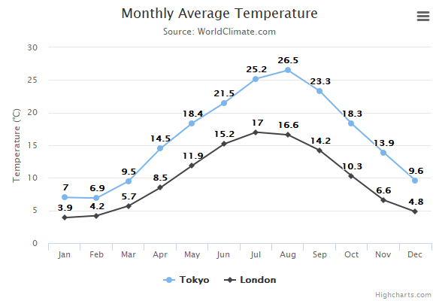
Line Chart
A line chart is a graph which uses lines to connect individual data points that display quantitative values over a specified time interval.

Slide 9
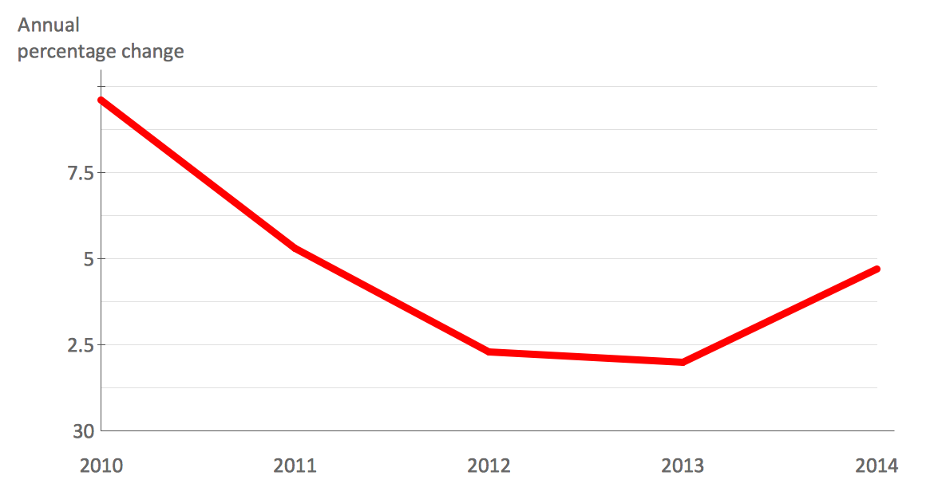
Time Series Graph
Time Series Graph is a line graph of repeated measurements taken over regular time intervals.

Slide 10
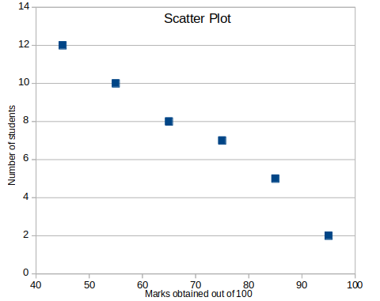
Scatter Diagram
A graph in which the values of two variables are plotted along two axes, the pattern of the resulting points revealing any correlation present.

